Slide 1
Gesture Recognition
And
Distance
Measurement
Milestone 2
BY: SHREYAS S N

Slide 2
Gesture Recognition And Distance Measurement
Tools and Technologies Used:
Core Technologies
MediaPipe – Framework for accurate hand landmark detection
OpenCV – Handles camera input and real-time video processing
NumPy – Performs mathematical computations
Pandas – Manages landmark data efficiently
Development Environment:
JupyterNotebook – For step-by-step code execution and testing
Anaconda – Environment manager for smooth package handling and setup

Slide 3
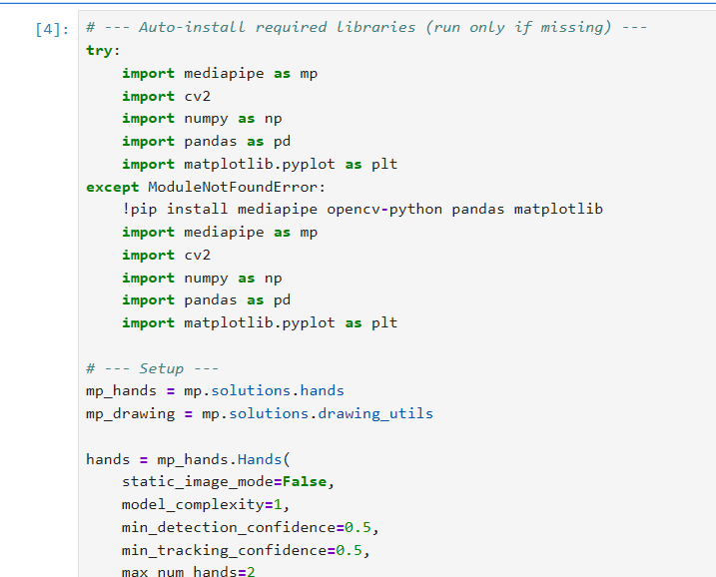
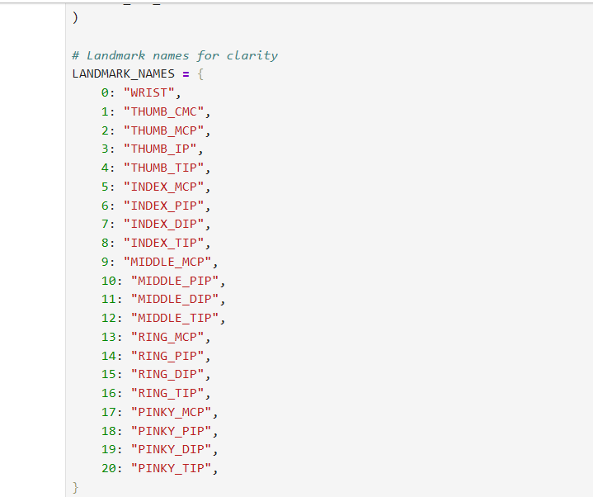
CODE: Gesture Recognition & Distance Measurement

Slide 4
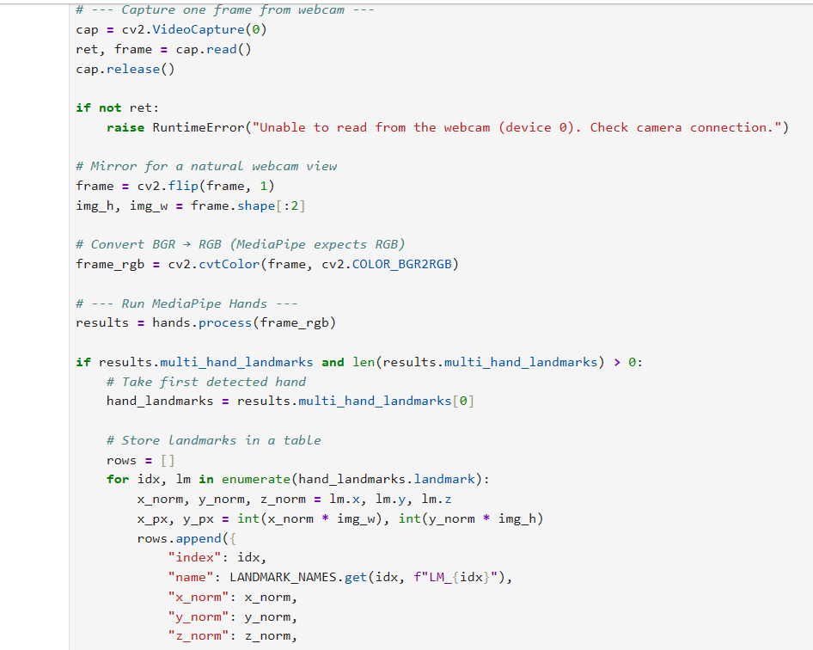
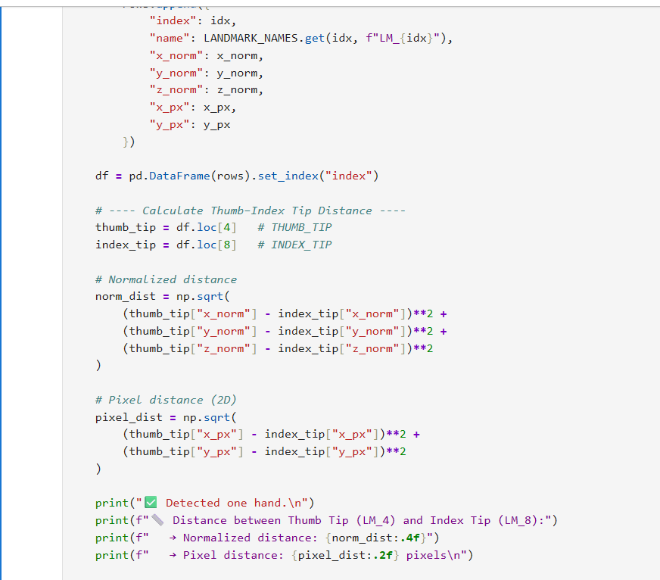

Slide 5
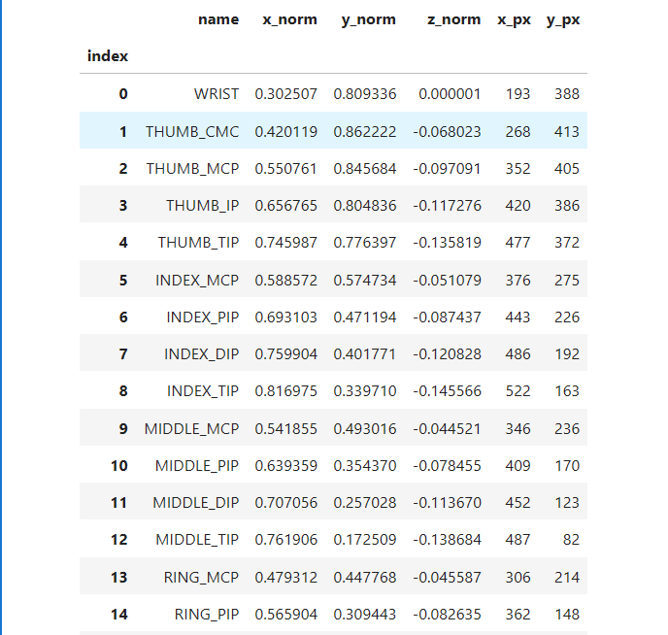
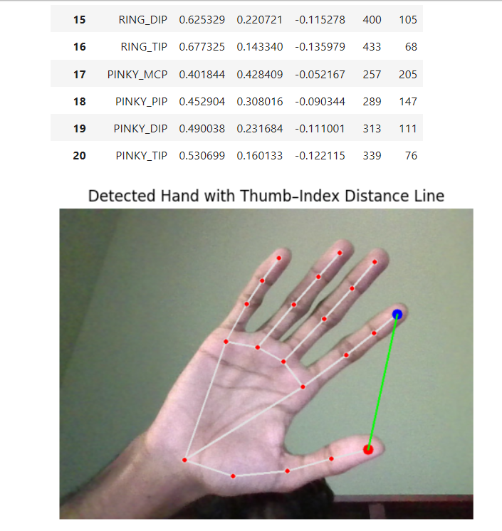
OUTPUTS

Slide 6
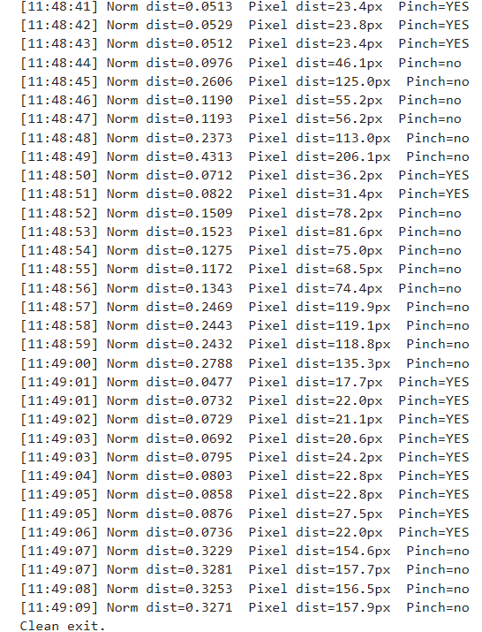
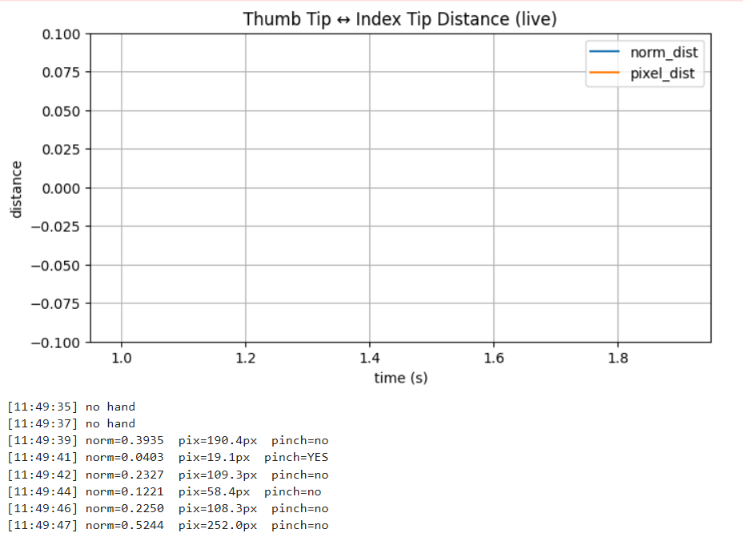

Slide 7
Frontend: Streamlit Interface for Gesture Recognition
Purpose:
To create a simple and interactive web-based UI for the Gesture Recognition module
Allows users to start or stop the camera, view real-time gesture detection, and display calculated distances
Key Features:
Built using Streamlit , a Python-based web framework
Start/Stop Camera Buttons – Enables live control of webcam feed
Live Distance Display – Continuously shows thumb–index fingertip distance
Gesture Status – Shows “Pinch” or “Open Hand” based on detected gesture
Adjustable Controls –
  Minimum detection confidence slider
  Pinch distance threshold selector
Working Flow
User clicks “Start Camera” → Streamlit activates webcam using OpenCV
Frame sent to MediaPipe model → Detects hand landmarks
Distance calculated → Displayed dynamically on screen
Annotations shown live → Visual line between thumb & index finger
User clicks “Stop Camera” → Safely closes video stream

Slide 8
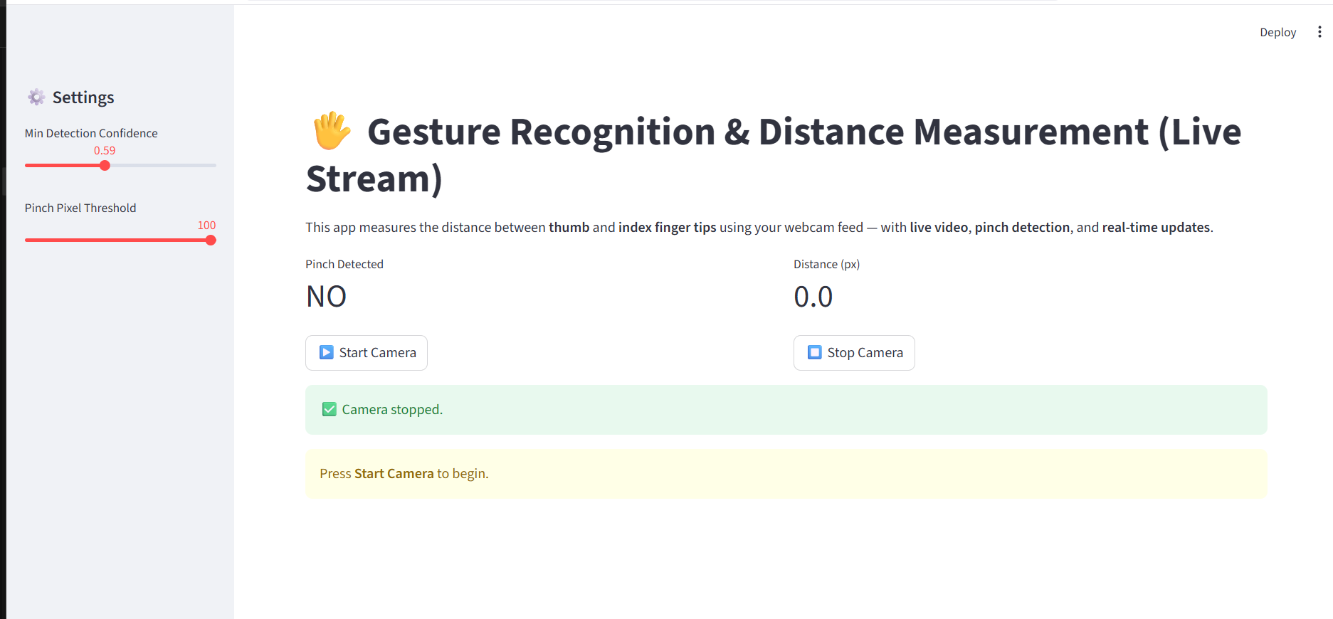
OUTPUT

Slide 9
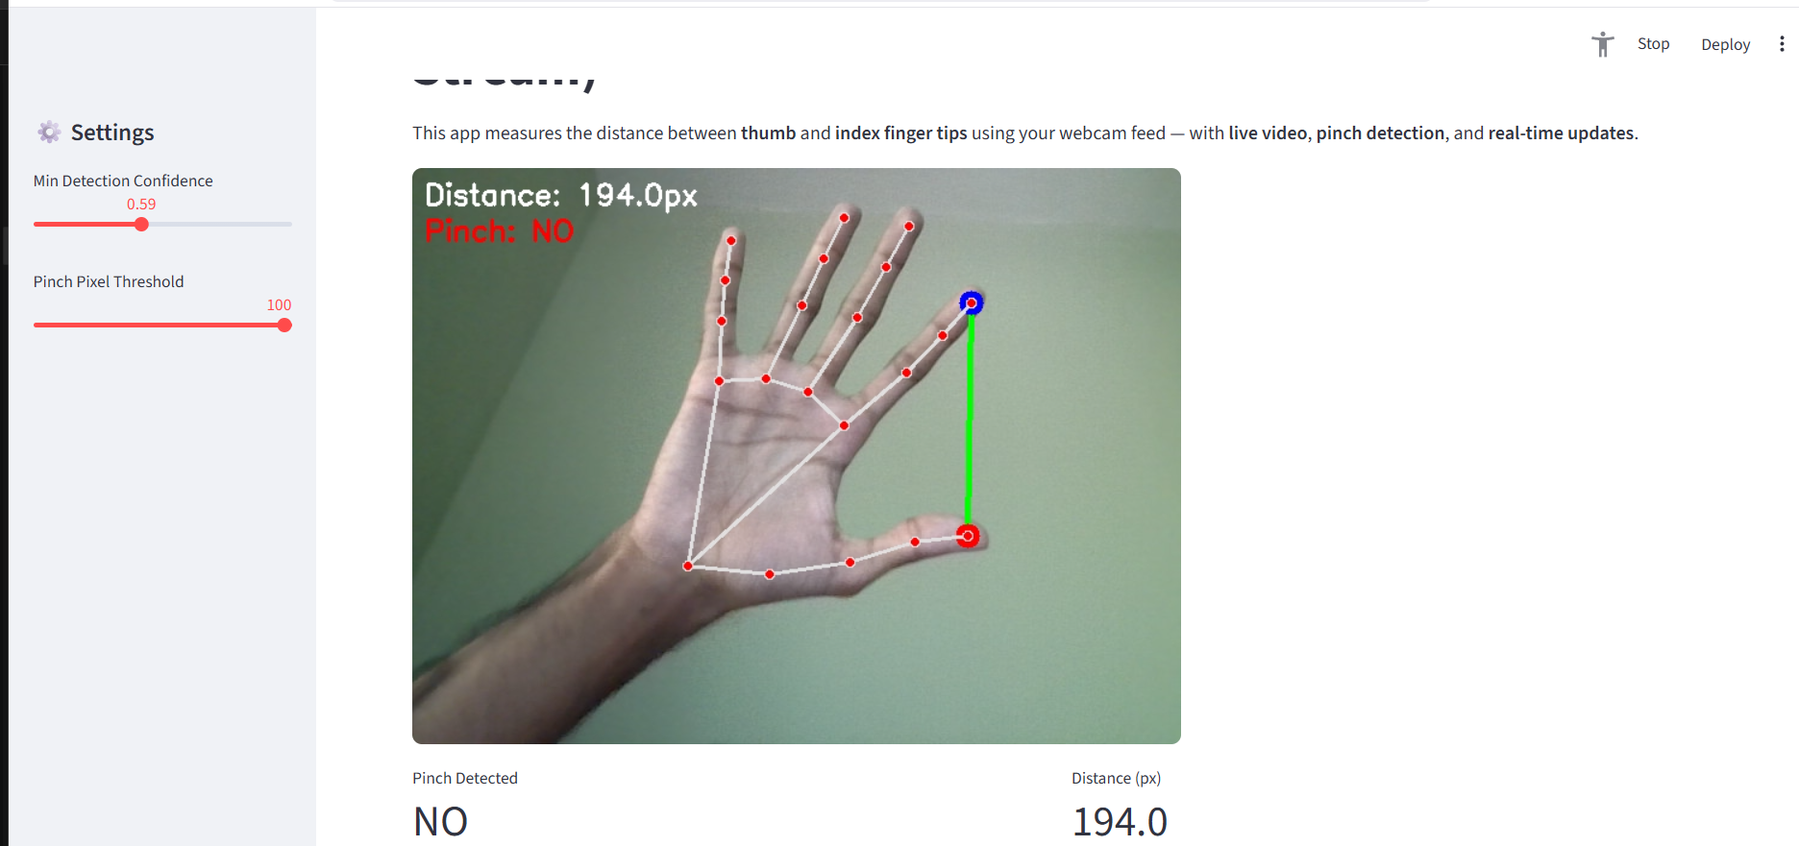
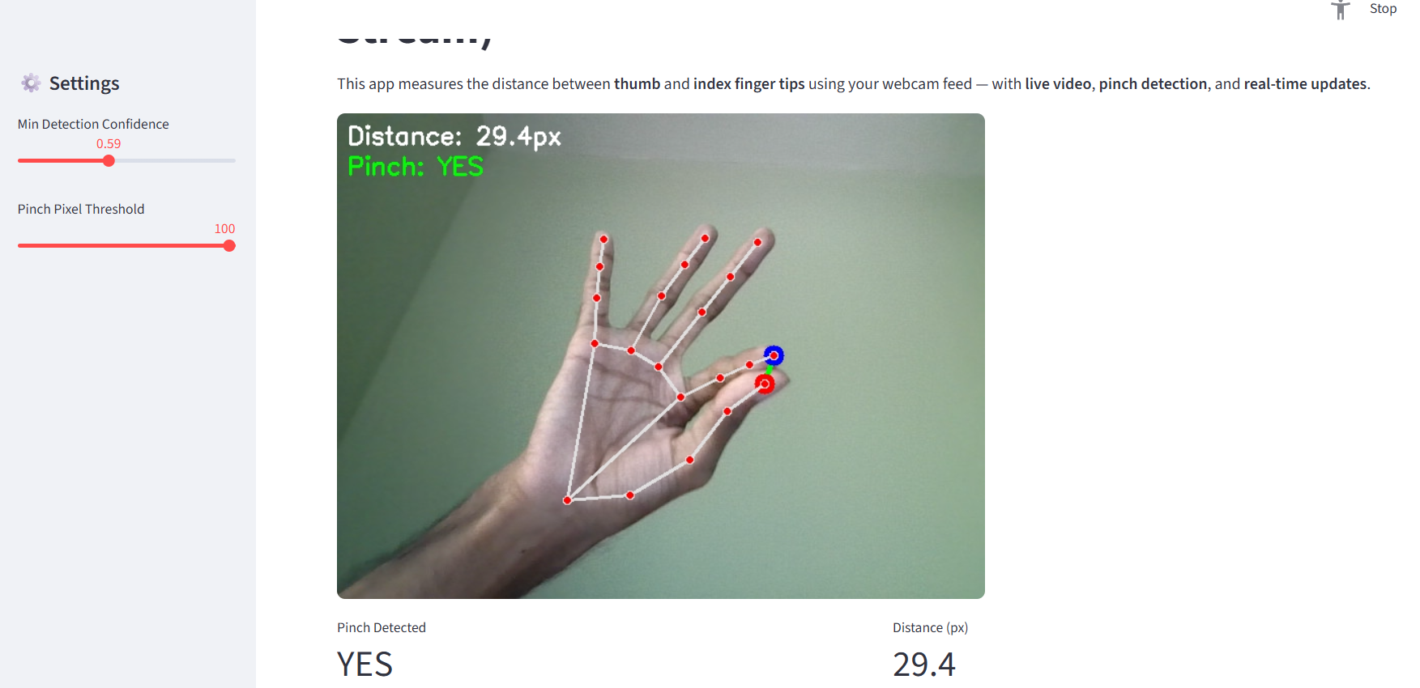

Slide 10
Thank you !!!

